Slide 1

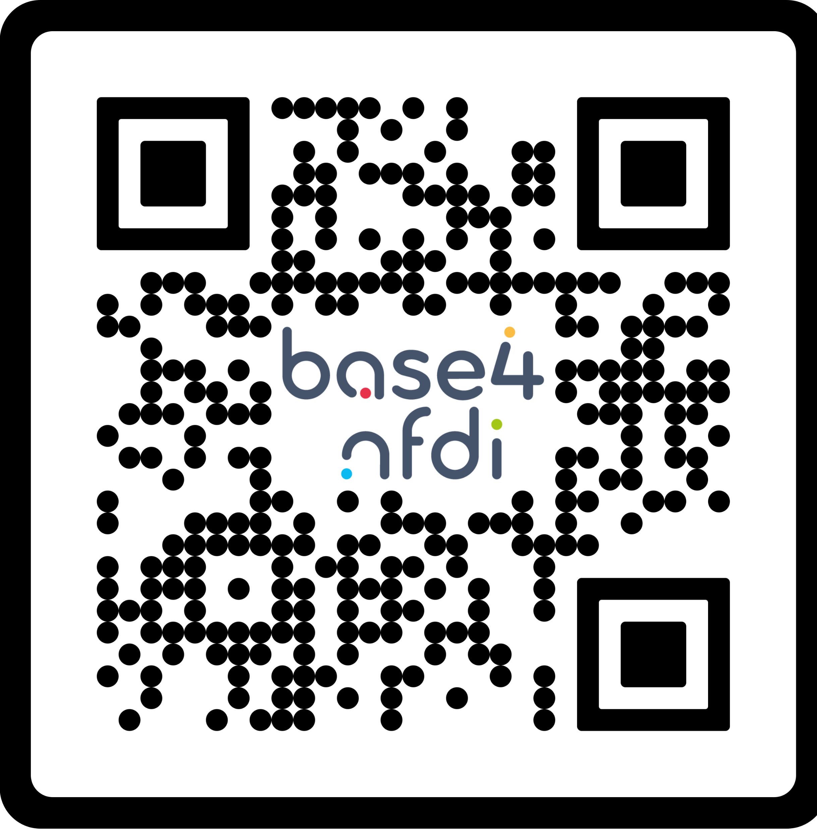






www.base4nfdi.de
Title
Subtitle / abstract
more text
Heading
text
Contact: base4nfdi-office@lists.nfdi.de
License: CC BY 4.0
Icons: add attributions for used icons here
Funded by DFG as part of NFDI. Grant Numbers: 521453681, 521460392, 521462155,
521463400, 521466146, 521471126, 521473512, 521474032, 521475185, 521476232
Layout: Base4NFDI-Office
Editors: add name of editors here
Event: add name of event here

Slide 2

www.base4nfdi.de
Contact: base4nfdi-office@lists.nfdi.de
License: CC BY 4.0
Funded by DFG as part of NFDI. Grant Numbers: 521453681, 521460392, 521462155,
521463400, 521466146, 521471126, 521473512, 521474032, 521475185, 521476232
Layout: Base4NFDI-Office
Editors: add names of editors here
Event: add name of event here

Slide 3

www.base4nfdi.de
Heading
Heading
Heading
Text
Bullets
Text
and bullets
Contact: base4nfdi-office@lists.nfdi.de
License: CC BY 4.0
Funded by DFG as part of NFDI. Grant Numbers: 521453681, 521460392, 521462155,
521463400, 521466146, 521471126, 521473512, 521474032, 521475185, 521476232
Layout: Base4NFDI-Office
Editors: add names of editors here
Event: add name of event here

Slide 4
Inspiration
Our posters on Zenodo:
Base4NFDI - General Introduction (RDA DE 2024). https://doi.org/10.5281/zenodo.10691410
Base4NFDI - Basisdienste für FDM. FDM@Campus 2024.
https://doi.org/10.5281/zenodo.14604119
Facilitating the development of a diverse service landscape – Tasks and roles of Section Liaison Officers and Service Stewards within Base4NFDI (RDA DE 2024, 4Biodiv AHC 2024). https://doi.org/10.5281/zenodo.10681450
What is Base4NFDI? (CoRDI 2023). https://doi.org/10.5281/zenodo.8296366
Base4NFDI: Supporting RDM Activities via Sustainable Core Services (EOSC Symposium 2024). https://doi.org/10.5281/zenodo.13986626
TS4NFDI:
  Harmonizing Terminology Services within NFDI (NFDI4Biodiversity AHC 2024). https://doi.org/10.5281/zenodo.12542465
  Harmonizing Terminology Services within NFDI (NFDI4Objects CM 2024). https://doi.org/10.5281/zenodo.13846878
  A terminology service via TS4NFDI for BERD@NFDI knowledge graph infrastructure (UC4B2024). https://doi.org/10.5281/zenodo.14230727
  Harmonizing Terminology Services within NFDI. (NFDI4Microbiota AC 2024). https://doi.org/10.5281/zenodo.14284423
PID4NFDI: A Base4NFDI Service to Enhanced Research Data Management. https://doi.org/10.5281/zenodo.13735557
KGI4NFDI: The NFDI Knowledge Graph Infrastructure service for FAIR data management (EOSC Symposium 2024). https://doi.org/10.5281/zenodo.13712824
Base4NFDI und Text+ (Text+ Plenary 2022). https://doi.org/10.5281/zenodo.7252006

